Slide 1

MUSIC STORE MANAGEMENT SYSTEM
VAISHNAVI SONAR
Batch No: 380

Slide 2
About me
Degree: BE (ECE)
University: PDA ENGINEERING COLLGE
Year of Graduation: 2024

Slide 3
Agenda
Objective of the Project
ER Diagram and schema explanation
Key analysis questions
SQL query results with screenshots or summaries
Final business insights and recommendations
Conclusion
Experience and Challenges working on this SQL – Data Analysis Project.

Slide 4
OBJECTIVE
The main objective of this project is to explore and analyze the Music Store database using SQL. The project aims to:
Understand how data is structured in a music business system.
Practice writing SQL queries using joins, subqueries, aggregate functions, and filtering.
Generate meaningful business insights such as:
Customer spending behavior
Top-performing genres and artists
High-revenue cities and countries
Best customers based on total purchases

Slide 5
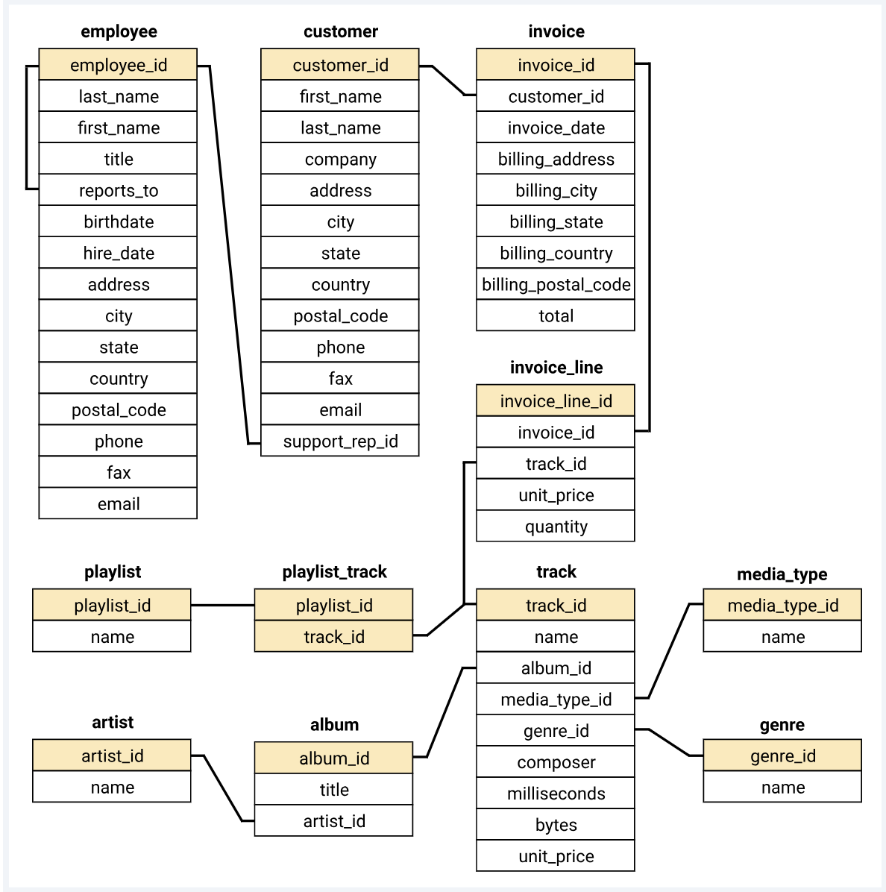
ER DIAGRAM:

Slide 6
Database Schema Explanation
Primary Keys (PK): Unique identifiers like artist_id, album_id, track_id ensure entity uniqueness.
Foreign Keys (FK): Establish connections, e.g., artist_id in Album links to Artist.
Tables & Columns:
Artist: artist_id, name
Album: album_id, title, artist_id
Track: track_id, name, album_id, media_type_id, genre_id, unit_price
Customer: customer_id, first_name, last_name, support_rep_id
Invoice: invoice_id, customer_id, invoice_date, total
Invoice Line: invoice_line_id, invoice_id, track_id, unit_price, quantity and so on…
Constraints: Auto-incremented PKs, cascade on deletes/updates for referential integrity.

Slide 7
Key Analysis Questions (use cases)
Who is the senior most employee based on job title?
Which countries have the most Invoices?
What are the top 3 values of total invoice?
Which city has the best customers? - We would like to throw a promotional Music Festival in the city we made the most money. Write a query that returns one city that has the highest sum of invoice totals. Return both the city name & sum of all invoice totals
Who is the best customer? - The customer who has spent the most money will be declared the best customer. Write a query that returns the person who has spent the most money
Write a query to return the email, first name, last name, & Genre of all Rock Music listeners. Return your list ordered alphabetically by email starting with A
Let's invite the artists who have written the most rock music in our dataset. Write a query that returns the Artist name and total track count of the top 10 rock bands
Return all the track names that have a song length longer than the average song length.- Return the Name and Milliseconds for each track. Order by the song length, with the longest songs listed first
Find how much amount is spent by each customer on artists? Write a query to return customer name, artist name and total spent
🇺🇳 We want to find out the most popular music Genre for each country. We determine the most popular genre as the genre with the highest amount of purchases. Write a query that returns each country along with the top Genre. For countries where the maximum number of purchases is shared, return all Genres
Write a query that determines the customer that has spent the most on music for each country. Write a query that returns the country along with the top customer and how much they spent. For countries where the top amount spent is shared, provide all customers who spent this amount

Slide 8
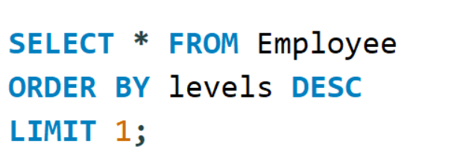

SQL Query Results With Screenshots Or Summaries 🔹1. Who is the senior-most employee based on job title?
Madan Mohan is the senior most employee in this organization. He is Senior
General Manager of this organization.

Slide 9
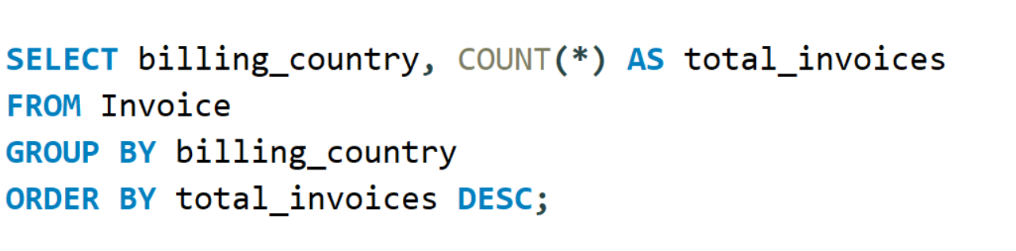
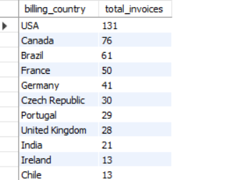
🔹2. Which countries have the most invoices?
The United States has the highest number of invoices, showing the strongest
customer engagement.

Slide 10
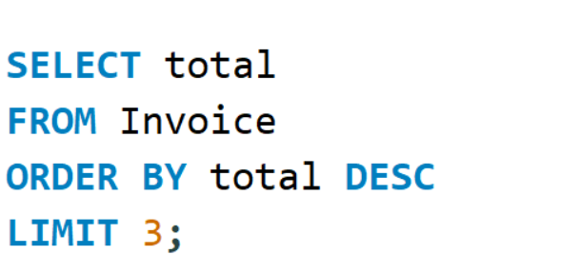
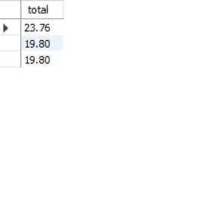
🔹3. What are the top 3 highest invoice totals?
The highest invoice total is $23.76, followed by two invoices each worth $19.80.

Slide 11
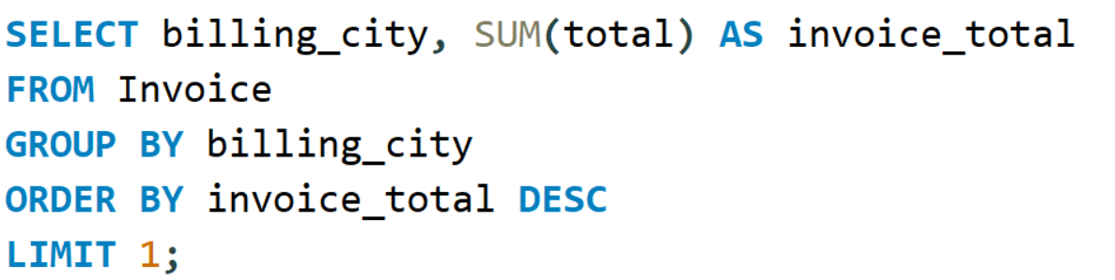
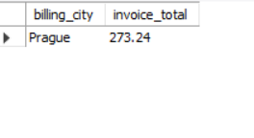
🔹4. Which city has the best customers (based on total invoice amount)?
Prague is the top-performing city in terms of revenue – making it the best location for a
promotional event.

Slide 12
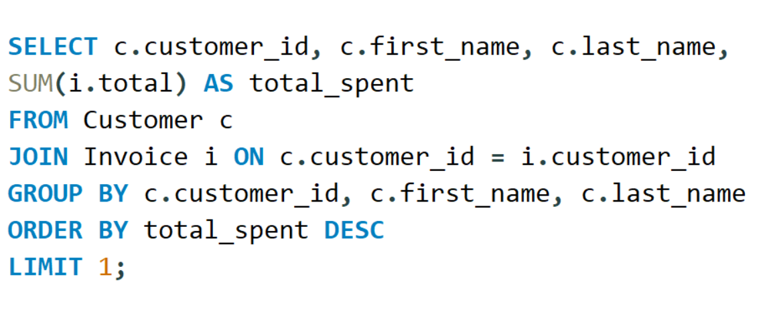
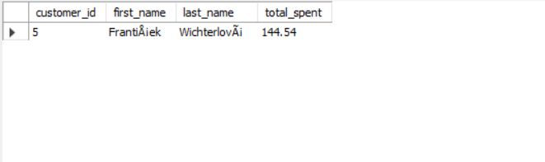
🔹5. Who is the best customer (spent the most)?
František Wichterlová is the best customer, having spent $144.54 in total.

Slide 13
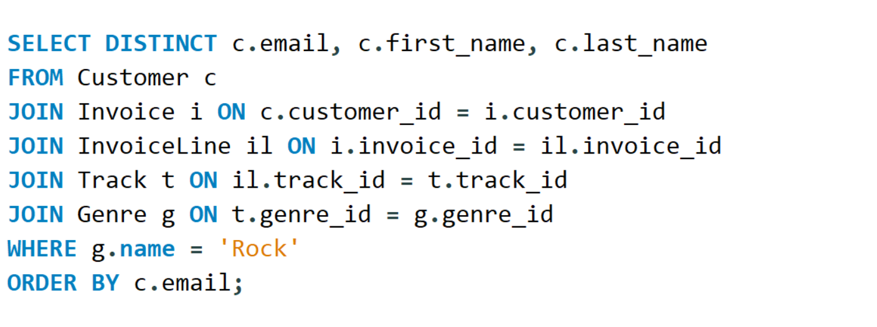
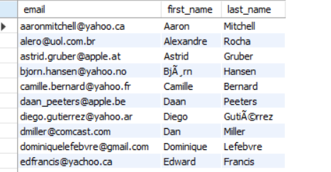
🔹6. All Rock Music listeners (with email, Firstname, Lastname)
The query filters and identifies all unique customers who have purchased Rock
tracks, and organizes them by email.

Slide 14
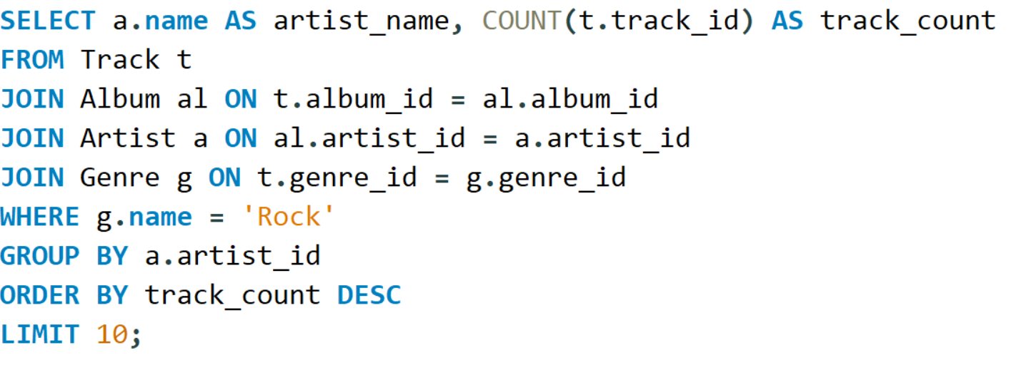
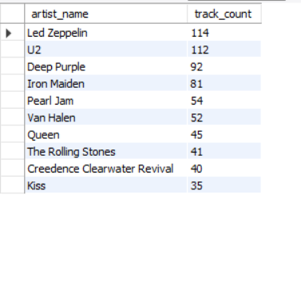
🔹7. Top 10 Rock Artists (based on song count)
These are the most prolific Rock artists in the dataset —ideal candidates for a
promotional campaign or rock music festival.

Slide 15
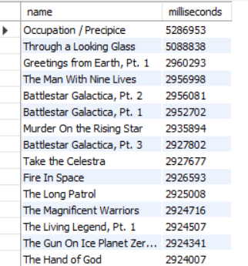
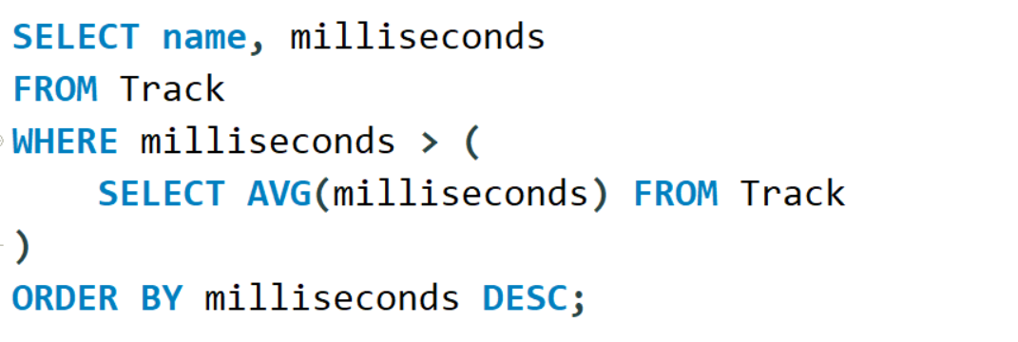
🔹8. Tracks longer than average duration
These tracks exceed the average song duration, indicating extended
compositions or instrumental pieces.

Slide 16
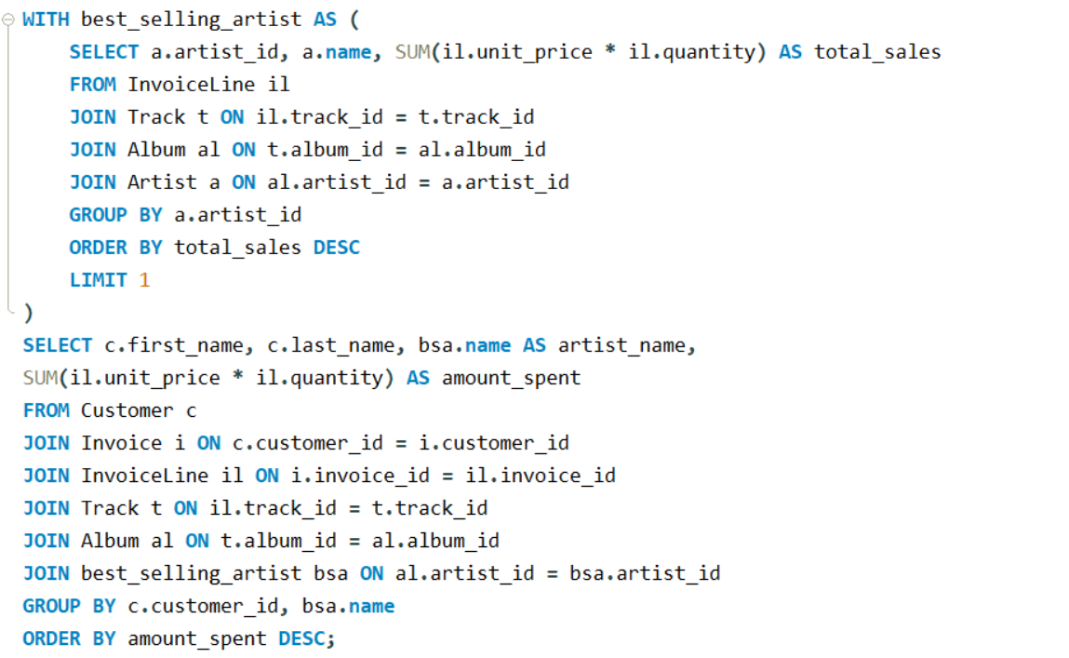
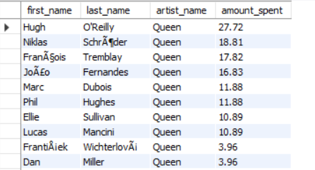
🔹9. How much has each customer spent on the top-selling artist?
This helps determine which customers contribute most to specific artist’s sales.

Slide 17
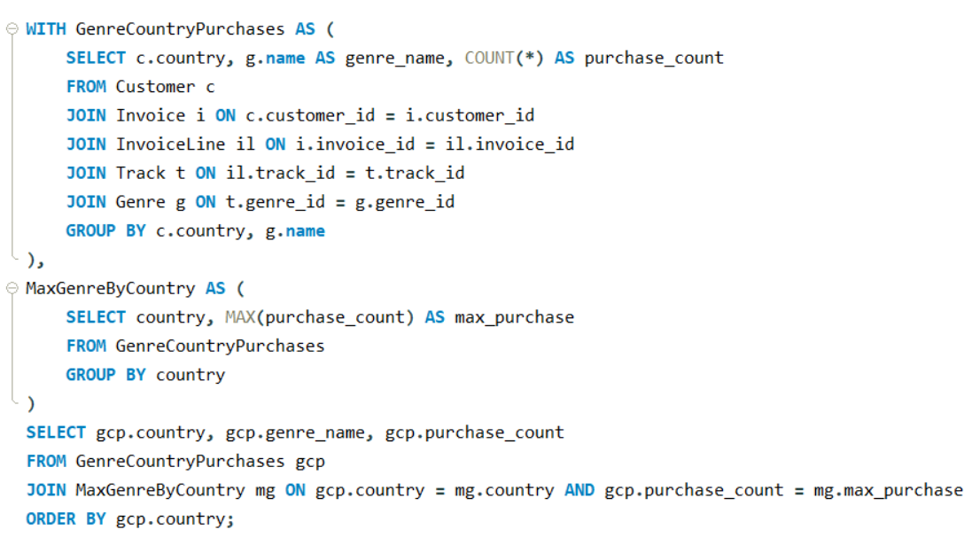
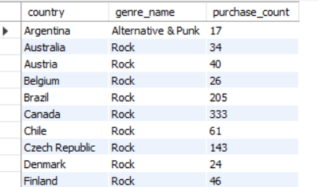
🔹10. Most popular genre in each country
This query shows the most purchased genre per country, helping with region-specific
music marketing or genre-focused promotions.

Slide 18
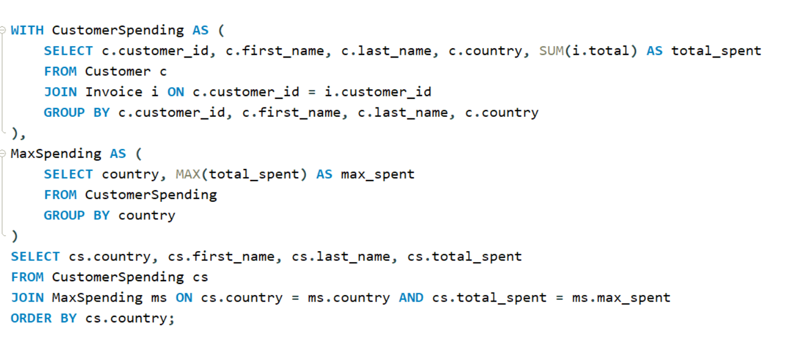
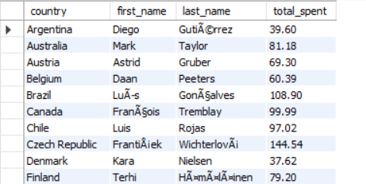
🔹11. Top spending customer in each country
This analysis is useful for identifying high-value customers by geography for loyalty
programs, promotions, or premium service targeting.

Slide 19
Final Business Insights
Rock is the most popular music genre among customers.
A small group of customers contributes to a large portion of total revenue.
Cities like Prague, Paris, and London have the highest customer spending.
Countries like the USA, Canada, and France generate the most invoices.
The senior-most employee can be identified to understand organizational hierarchy.
Some tracks are longer than average, which may indicate premium or special content.

Slide 20
CONCLUSION
Gained hands-on experience in SQL using a real music store database
Explored customer behavior, sales trends, and genre popularity
Learned to write complex queries using joins, subqueries, and grouping
Understood the importance of data relationships and schema design
Improved data analysis skills for business insights

Slide 21
Challenges & Learnings
One challenge I faced was importing large CSV files and dealing with foreign key errors. I resolved these by:
Importing tables in the correct order,
Using STR_TO_DATE() to fix date format issues,
Temporarily disabling foreign key checks.
This helped me understand database relationships better and improved my ability to write optimized SQL queries.

Slide 22

THANK YOU

